Slide 1


Slide 2
Online Examination System
LU Exam Hive

Slide 3
Designed & Crafted By:
LU Exam Hive
Mohammed Saduzzaman Sadi - 1712020101
Mohi Uddin Pabel - 1712020128
Toufique Ahmad - 1712020113

Slide 4
LU Exam Hive
Project Supervisor:
Minhazul Haque Bhuiyan
Assistant Professor & Assistant Proctor
Department of CSE
Leading University, Sylhet

Slide 5


An online examination system is a computer-based test system that can be used to conduct computer based tests online. This examination system uses fewer resources and reduces the need for question papers and answer scripts, exam room scheduling, arranging invigilators, coordinating with examiners, and more.

Slide 6

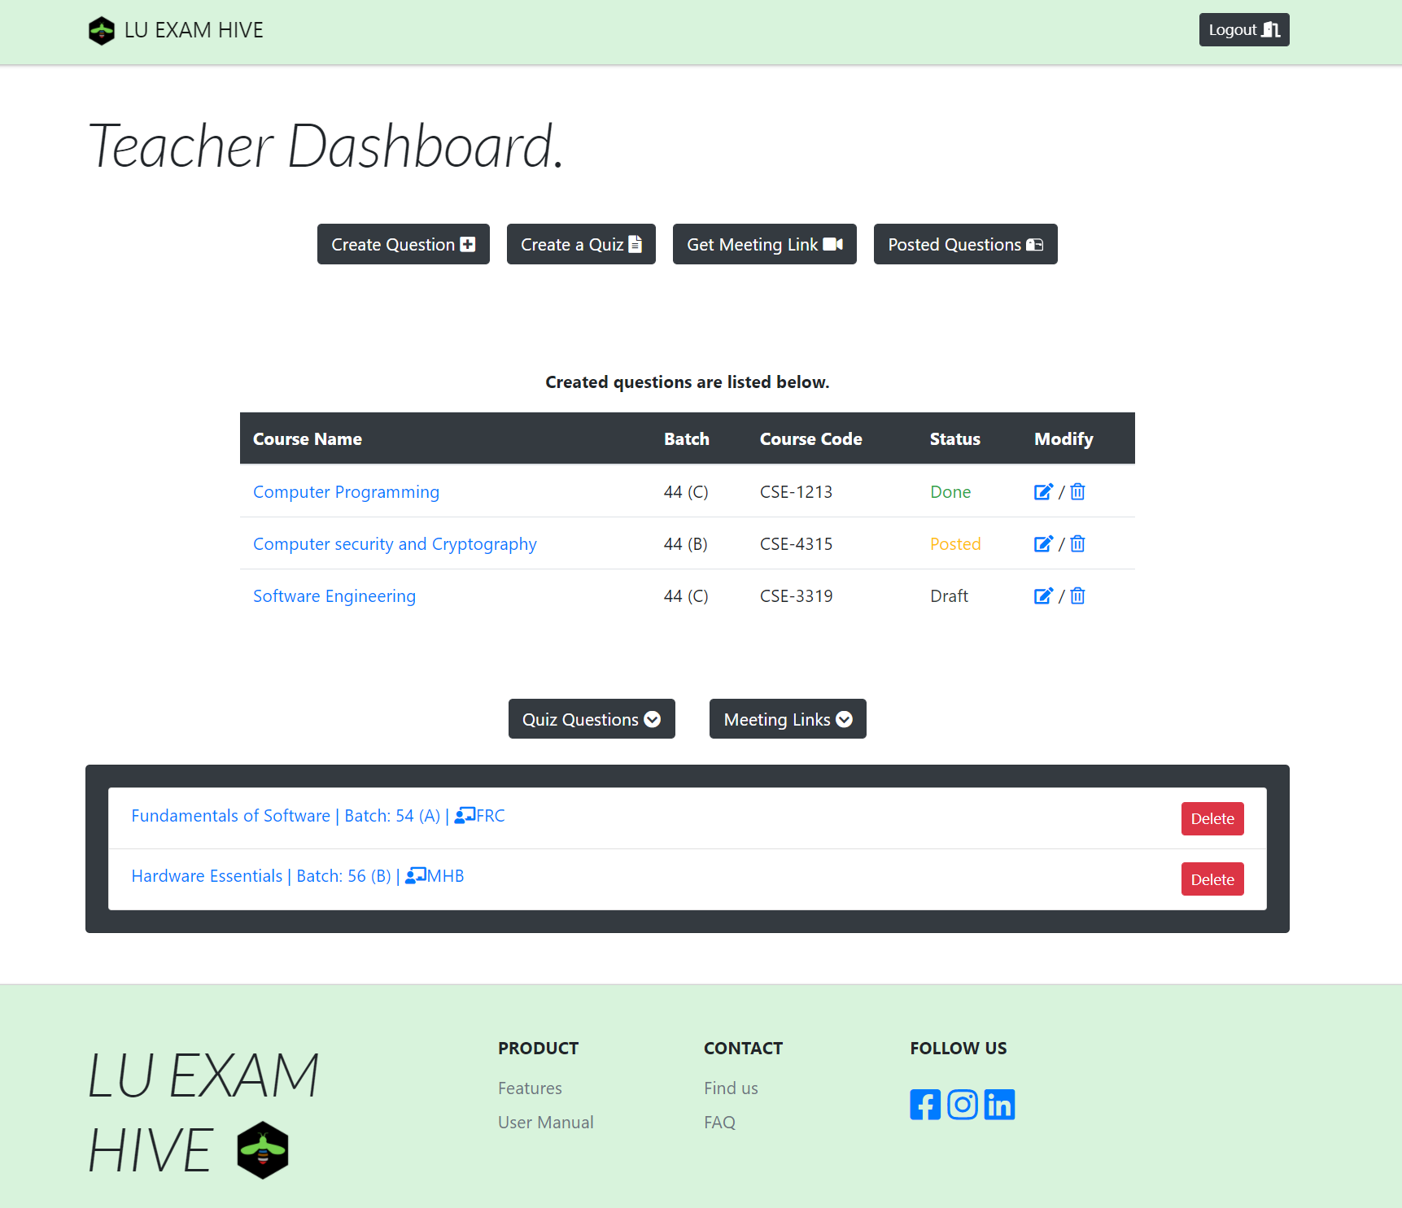


Widely Used
Integrated
LU Exam Hive

Slide 7



Audience
Teacher
No More:
Complex
UI
Student
We Prefer:
Effortless
UI
Admin

Slide 8

Vision
“Reach the heights”
LU Exam Hive

Slide 9
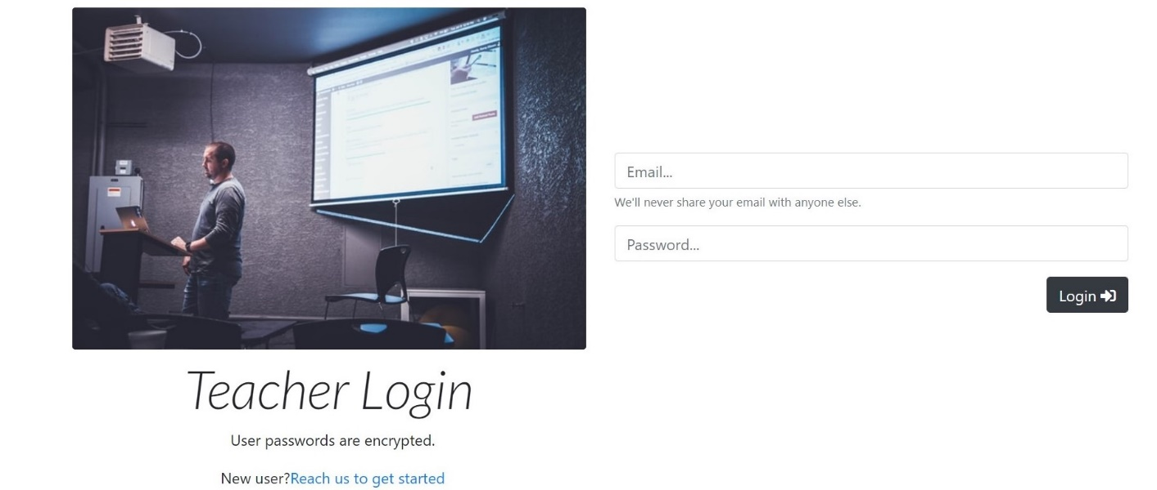
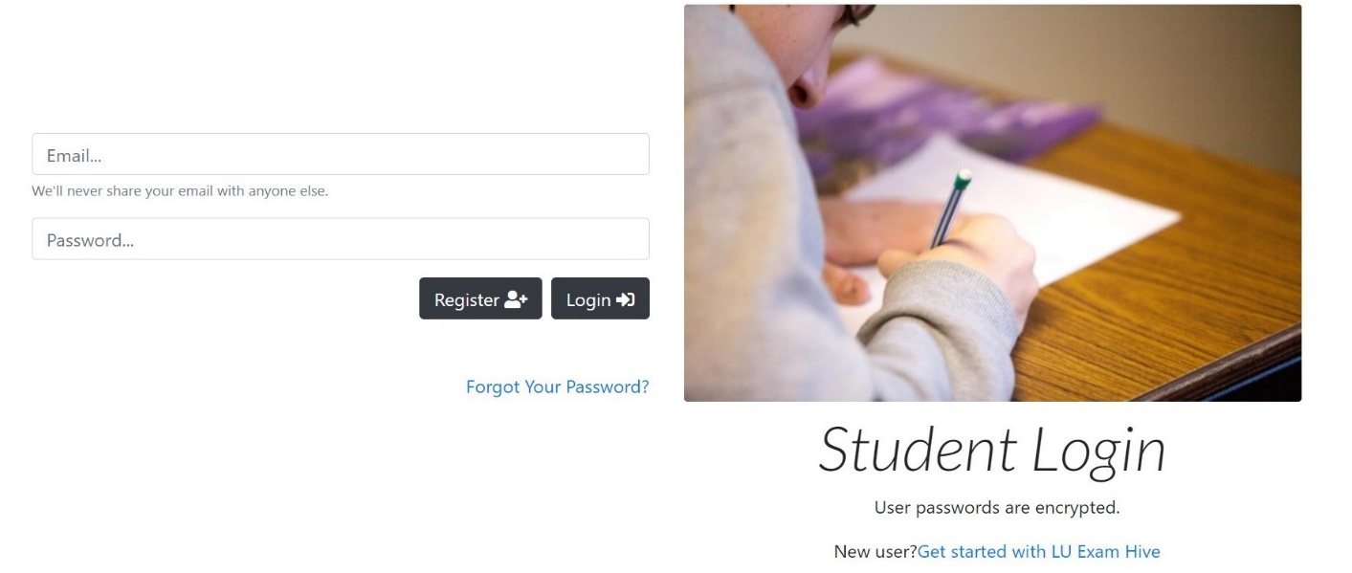
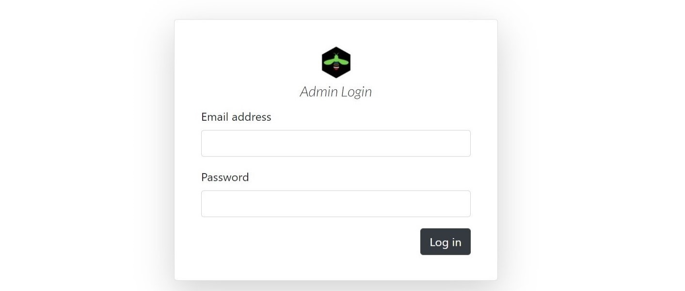
Avatars
Teacher Avatar
Student Avatar
Admin Avatar

Slide 10



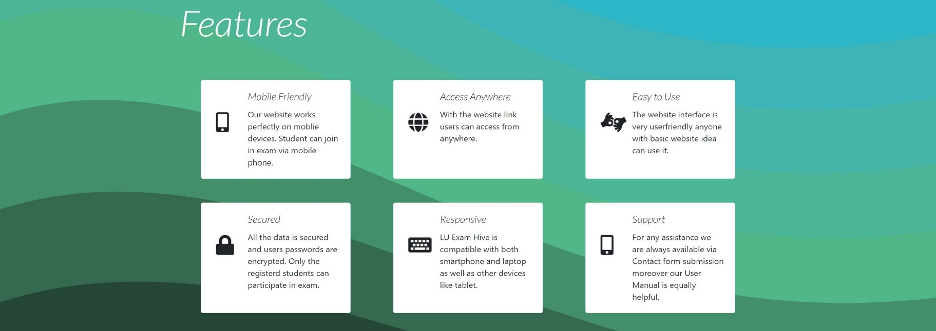
SVG
SVG stands for Scalable Vector Graphics. It is used to define vector-based graphics for the Web. Every element and every attribute in SVG files can be animated.

Slide 11
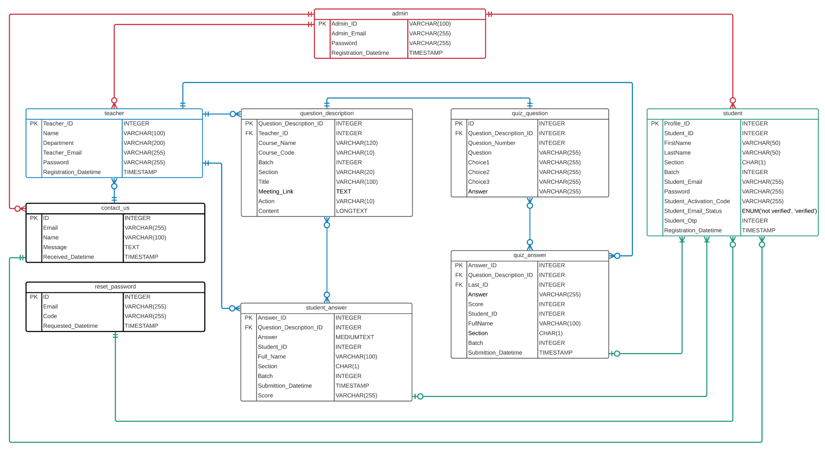

Database Design & Storage Engine
ACID compliance
Crash-recovery
Row-level locking
FOREIGN KEY
Increase multi-user
Fig: ER-Model of LU Exam Hive

Slide 12



Mailer
PHPMailer is a code library to send emails safely and easily via PHP code from a web server.
Validates email addresses automatically
Protects against header injection attacks
Error messages in over 50 languages
Compatible with PHP 5.5 and later
Namespaced to prevent name clashes
Integrated SMTP support

Slide 13


request_reset_password.php
student_Registration.php
contact.php

Slide 14
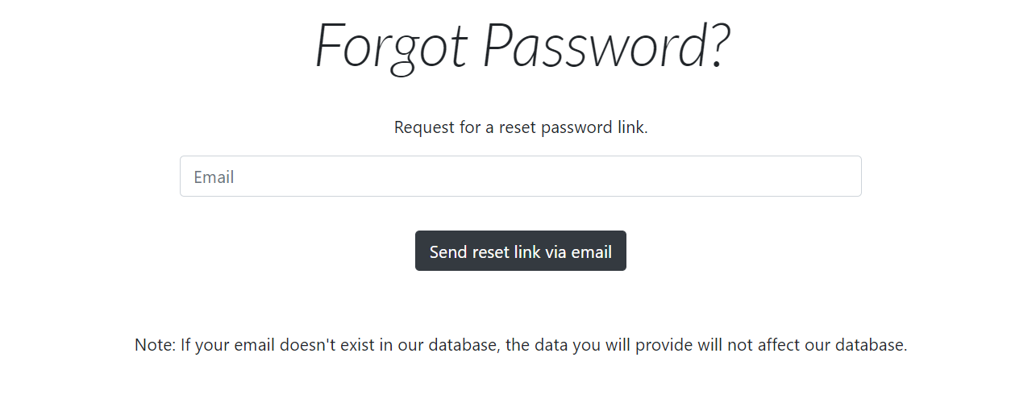
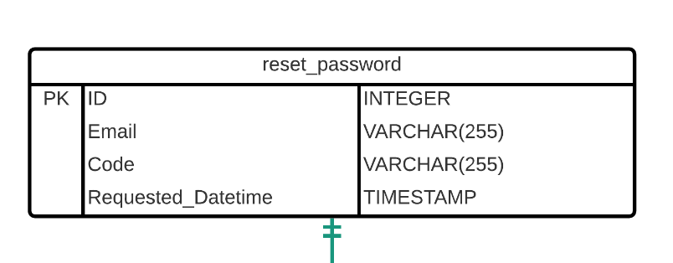
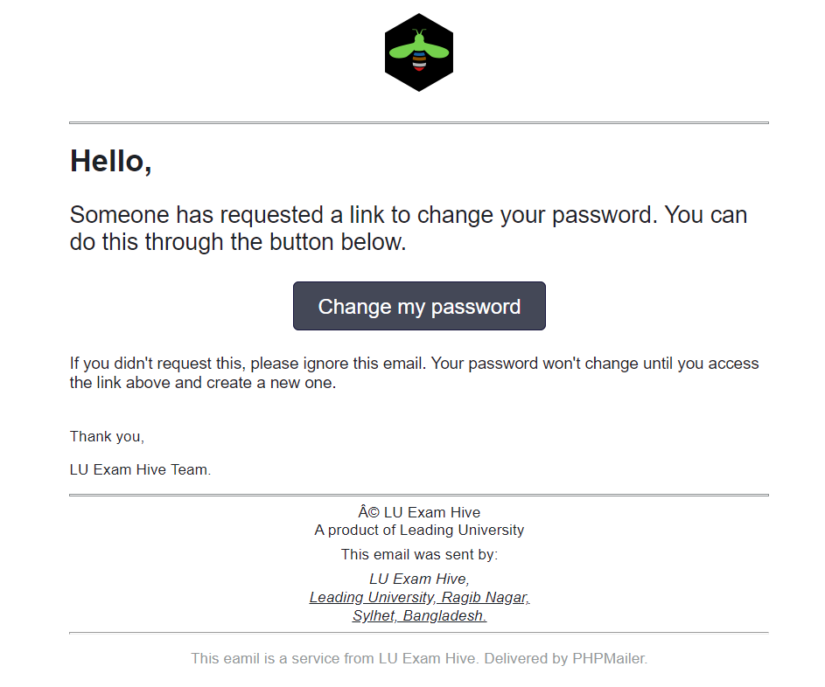
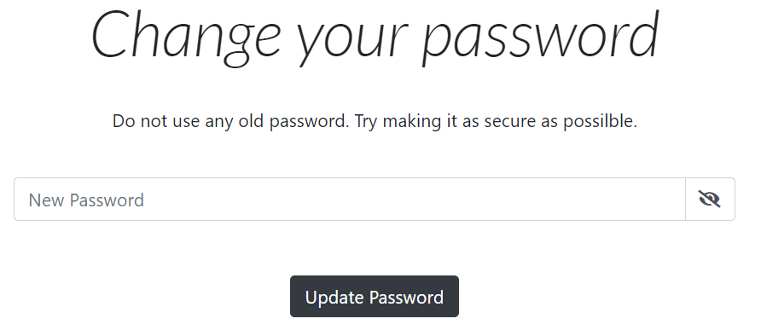
Did you forget your password again??

Slide 15
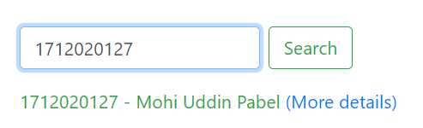
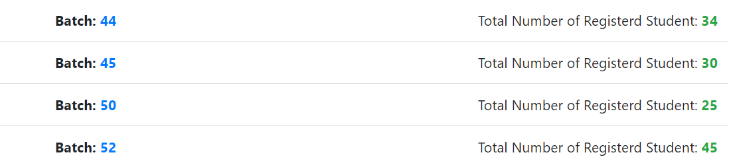
Effective Search
if (isset($_POST["search"])) {
$id = $_POST["id_to_search"];
$sql = $pdo->prepare("SELECT * FROM `Student` WHERE Student_ID = '$id'");
$sql->setFetchMode(PDO::FETCH_OBJ);
$sql->execute();
if ($row = $sql->fetch()) {?>
<p class="mt-3 text-success">
<?php echo $row->Student_ID . ' - ' . $row->FirstName . ' ' . $row->LastName . ' '; ?>
<a href="admin_student_details.php?id=<?php echo $row->Student_ID; ?>"> (More details)</a>
</p>

Slide 16
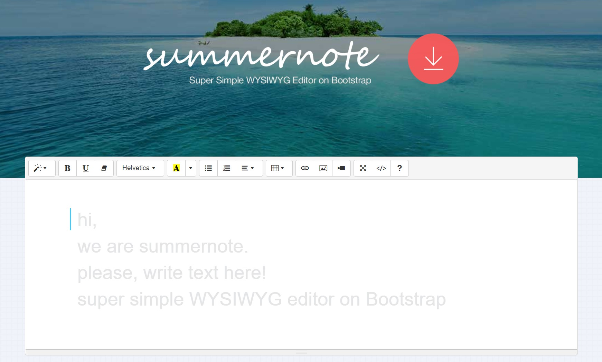
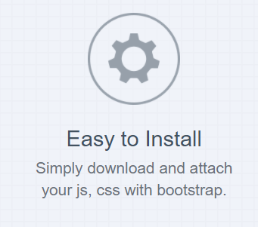
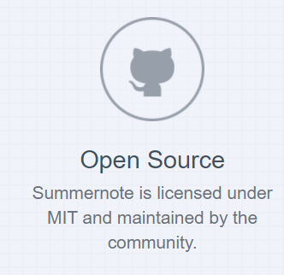
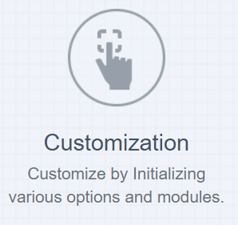

WYSIWYG Editor
Summernote is a JavaScript library that helps you create WYSIWYG editors online.

Slide 17


FPDF is a PHP class which allows to generate PDF files with pure PHP, that is to say without using the PDFlib library.
How We Generate PDF
Main features
Choice of measure unit, page format and margins
Automatic line break and text justification
Image support (JPEG, PNG and GIF)
Colors
Links
Page compression

Slide 18



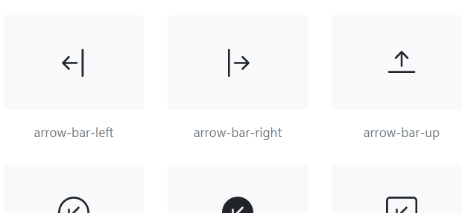


Bootstrap Framework HTML & CSS Templates Responsive Website
CSS FRAMEWORK & ICONS
Font Awesome icon toolkit

Slide 19

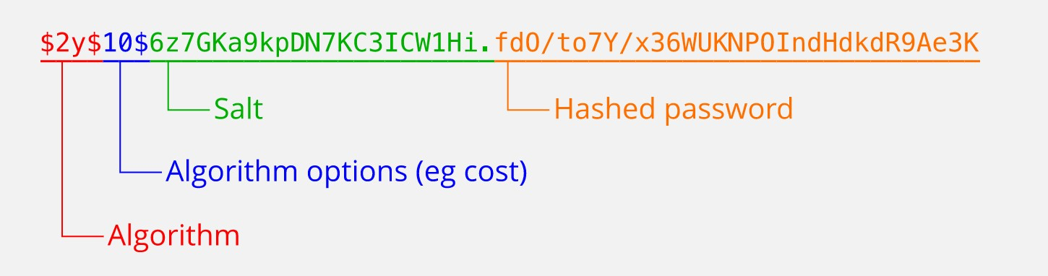
Encryption
Huge Number of Hash Database
1,154,870,188,082
Message-Digest Algorithm
Produce 128-bit hashed value
Not Reversible Function

Slide 20

Online Meetings
Schedule a Meeting
Use Google
Meet
Use Zoom
Google Meet is a video-communication-service developed by Google.
Zoom Video Communications, Inc. is an American communications technology company, It provides video telephony

Slide 21



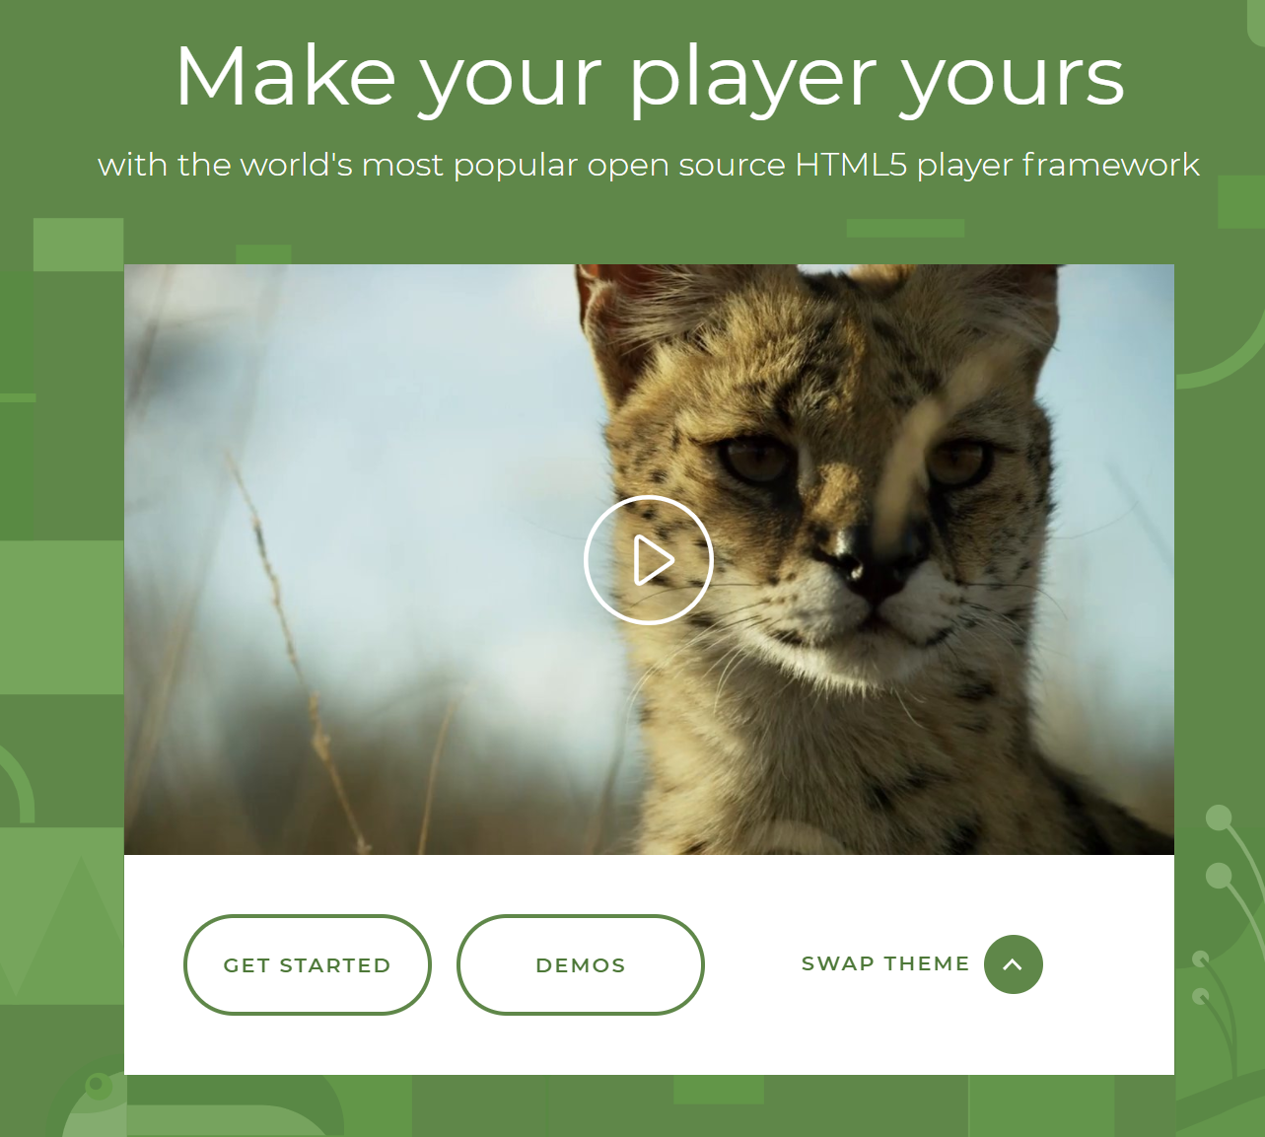
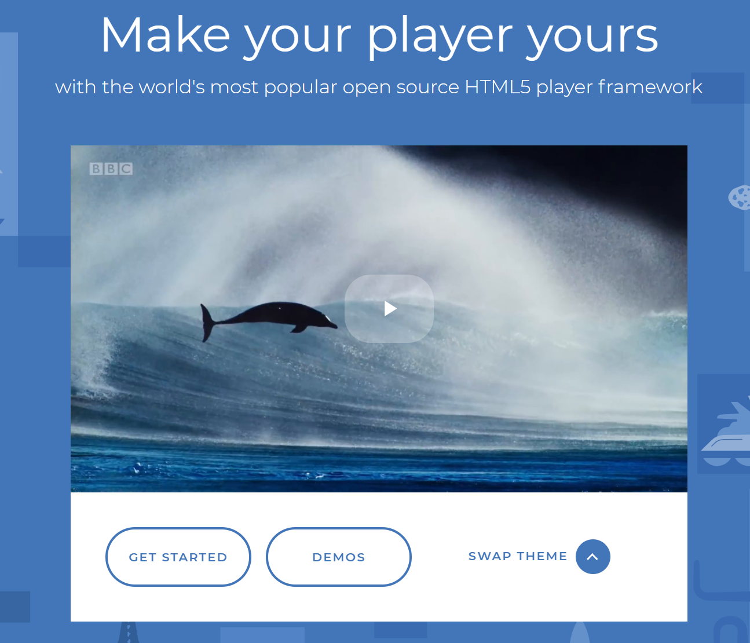
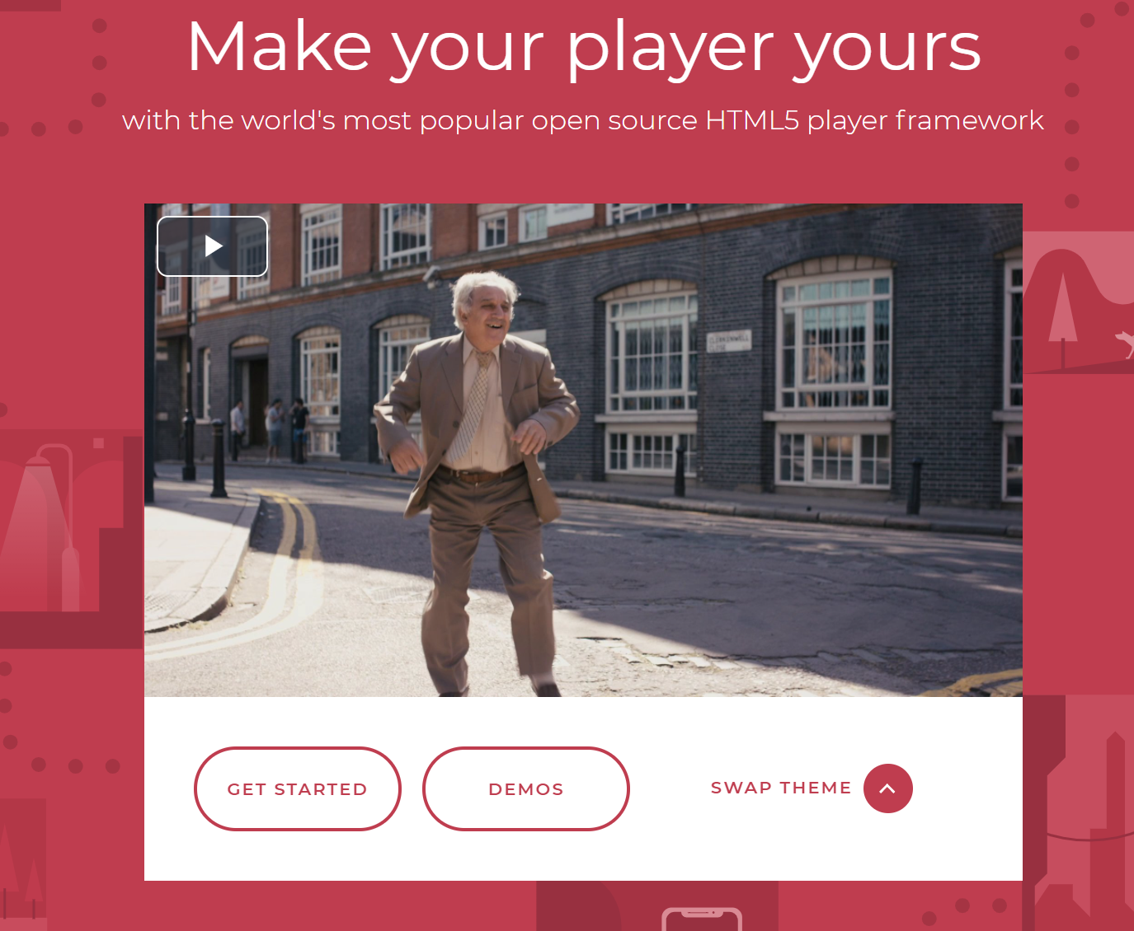
Media Player
Supports HTML5 video and streaming
Easy Plugins install Chromecast, IMA
Reliable and Consistent
Play Any format Videos

Slide 22



Conclusion

Slide 23
THE END

